Slide 1
Watershed Analysis
Chrys Adams

Slide 2
INTRODUCTION
Watershed is the region that flows through a given drainage point
Important for agriculture, flood analysis
Goal: Use elevation data to find the upstream watershed of some point.

Slide 3
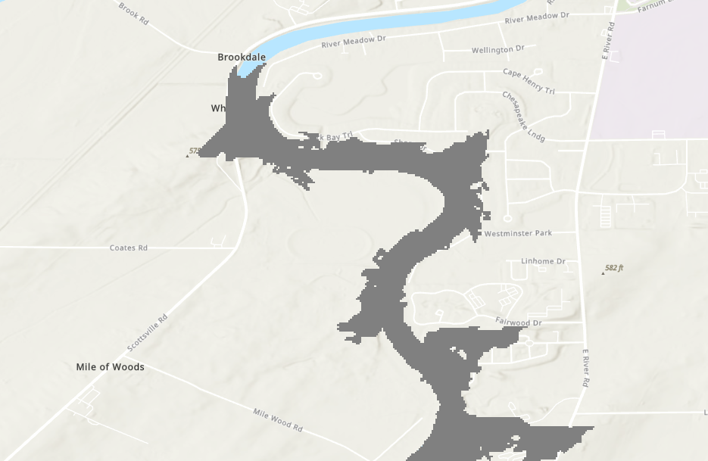
Overall Strategy
Start with some given point
For each neighbor, add more elevated points
Each new point repeats the process

Slide 4
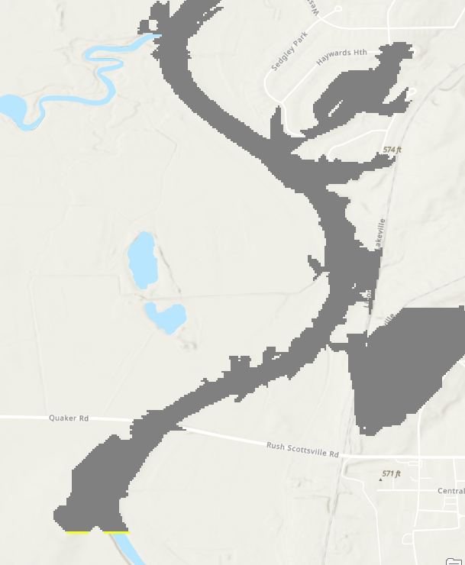
Issues
Only follows the streambed
Does not include side channel

Slide 5
Possible Fixes
Add some tolerance
Use a different strategy
Increase the radius of neighboring cells
Can lead to backwards flow
Simulating the flow of water down the slope
Flow can get caught in a basin
Algorithm takes too long
Algorithm takes longer
Able to jump small obstacles or noise
Decrease resolution/smoothing
Unimpressive results

Slide 6
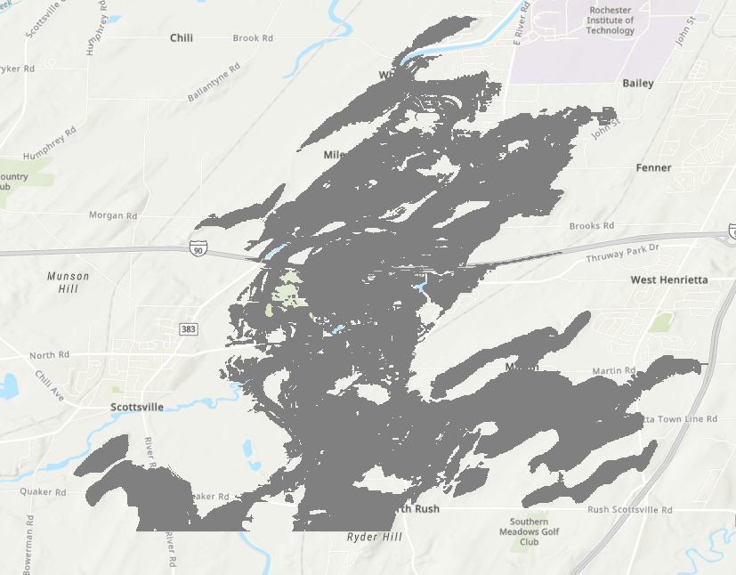
3nh Results
Much better fill
Runs in a reasonable amount of time

Slide 7
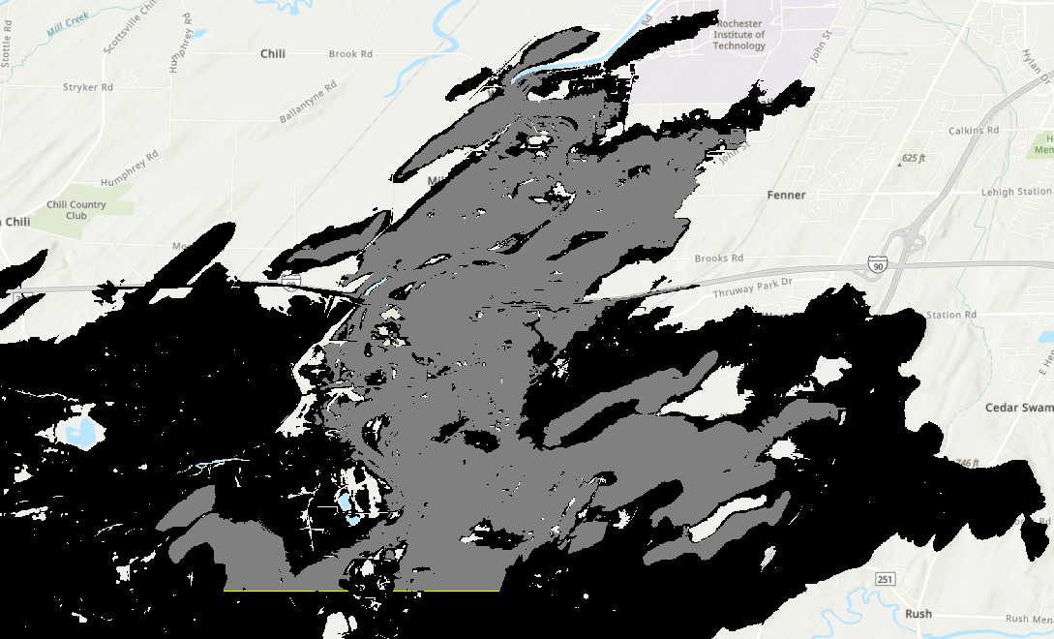
5nh Results
Note that the region is larger

Slide 8
Future Efforts
Can still get stuck
Larger neighborhoods increase computation time
Python can be slow
Compare against other models
Could use classification to identify bridges

